Slide 1
Bayesian cognitive and statistical modeling applied to Signal Detection Theory and the Mirror Effect in a perceptual task

Slide 2
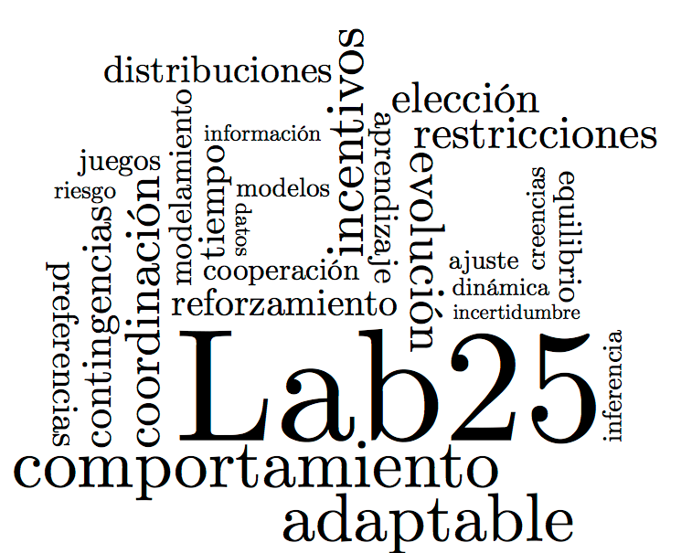
Introduction

Slide 3
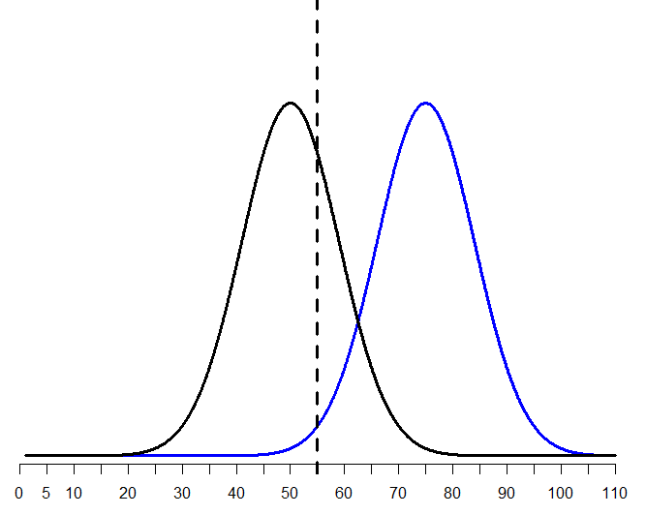
Signal Detection Theory

Slide 4
Recognition Memory

Slide 5
The Mirror Effect

Slide 6
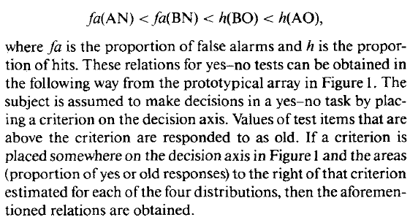

Slide 7
First Question
Is the Mirror Effect a

Slide 8
Method

Slide 9
Results: Did we replicate the effect?

Slide 10
A) Replication of the analysis reported in the M.E. literature
1.- Make sure that d’(A) > d’(B)
2.- Comparing the Hit and F.A. rates to test the M.E. pattern of response
3.- Comparing the Mean confidence ratings assigned to each class of stimuli.

Slide 11
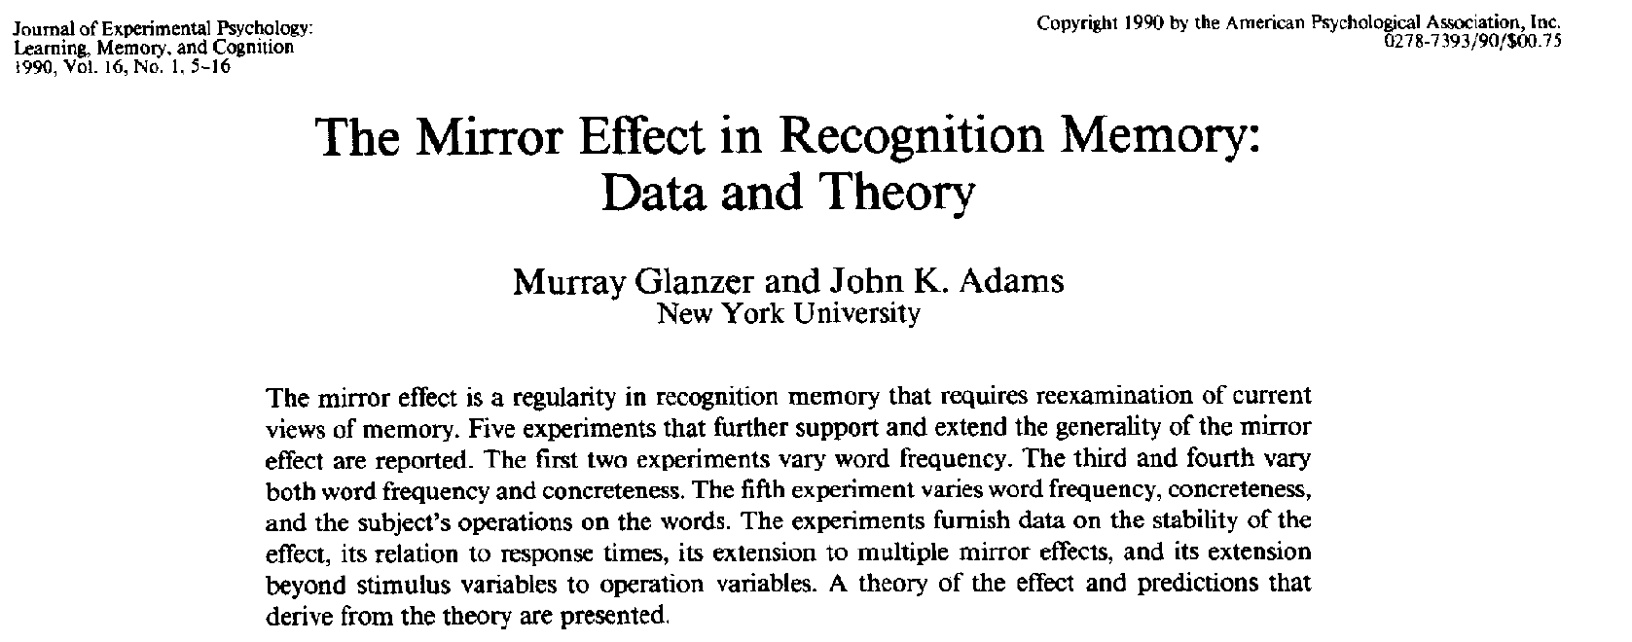
A) Replication of the analysis reported in the M.E. literature
Our replication was done step-by-step as reported in:
2.- Comparing the Hit and F.A. rates to test the M.E. pattern of response
Computing the Hit and F.A. rate per participant and do an arcsine transformation
3.- Comparing the Mean confidence ratings assigned to each class of stimuli.

Slide 12
A) Replication of the analysis reported in the M.E. literature
1.- Make sure that d’(A) > d’(B)
Calculate d’ for each class of stimuli, per participant
t-test!
2.- Comparing the Hit and F.A. rates to test the M.E. pattern of response
3.- Comparing the Mean confidence ratings assigned to each class of stimuli.

Slide 13
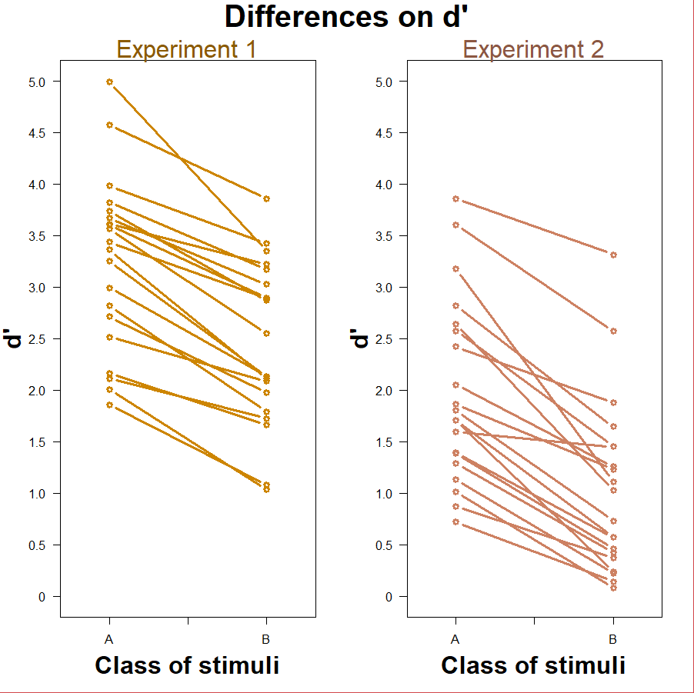
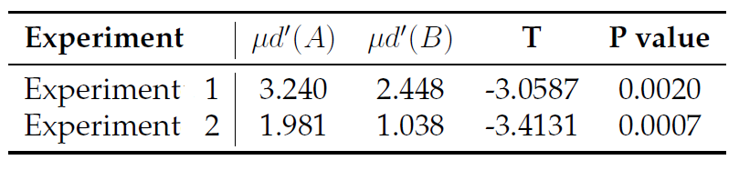
Making sure d’(A) > d’(B)

Slide 14
A) Replication of the analysis reported in the M.E. literature
1.- Make sure that d’(A) > d’(B)
2.- Comparing the Hit and F.A. rates to test the M.E. pattern of response
Compute the Hit and F.A. rates per participant and apply an arcsine transformation
Compare Hit rates and F.A. rates with two different t-tests!
3.- Comparing the Mean confidence ratings assigned to each class of stimuli.

Slide 15
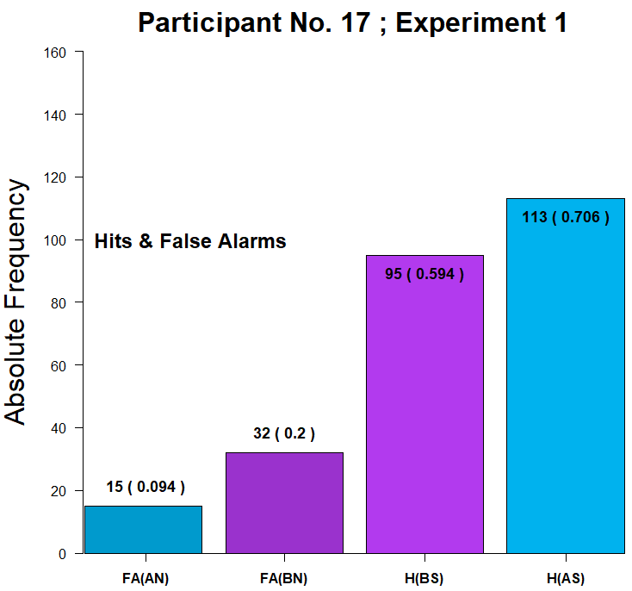
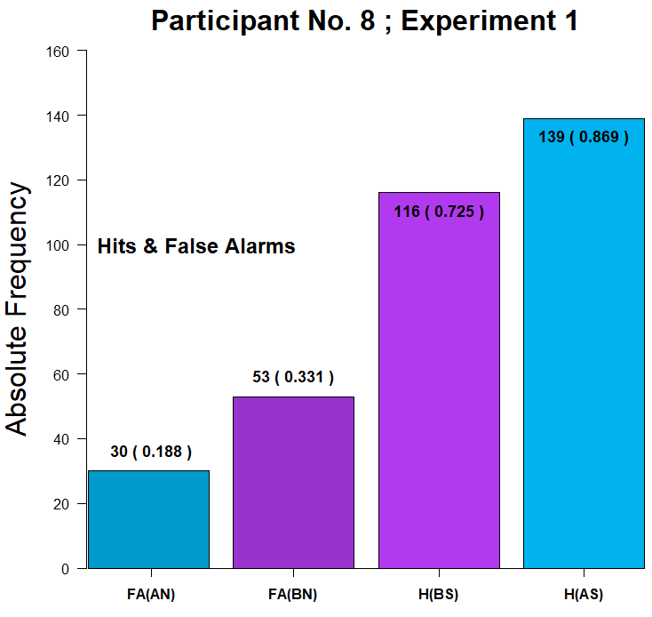
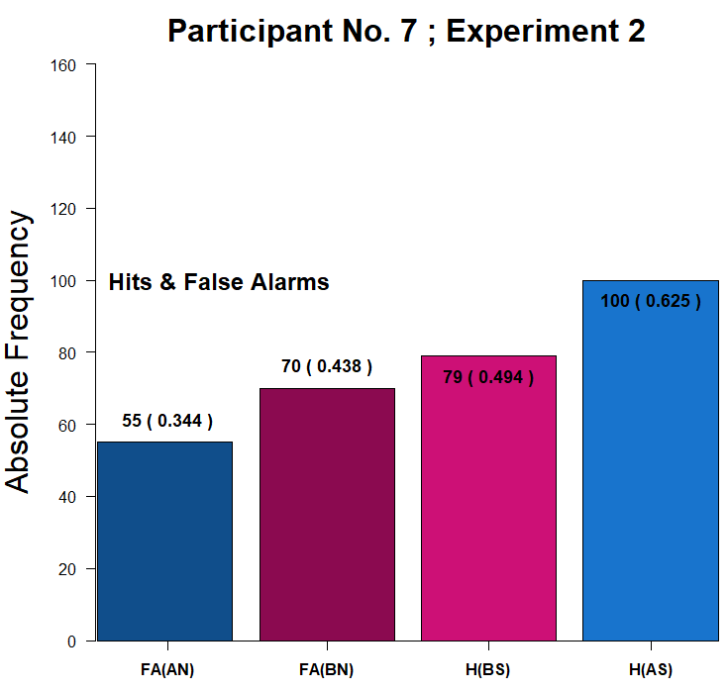
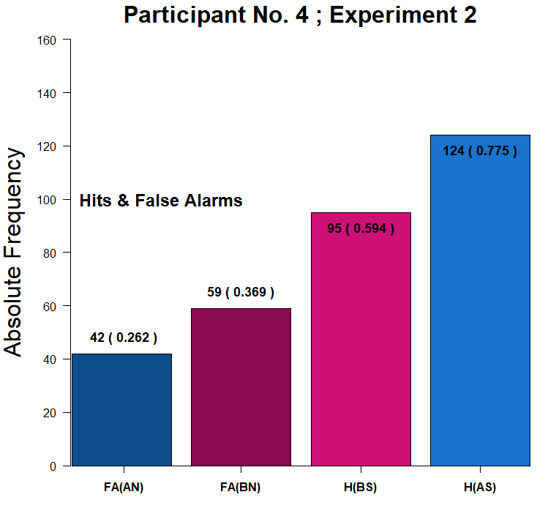
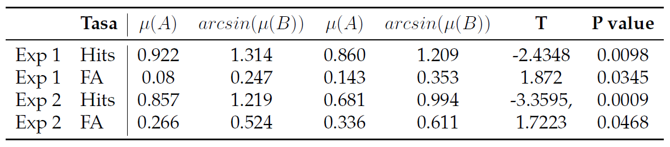
F(A) < F(B) < H(B) < H(A)

Slide 16
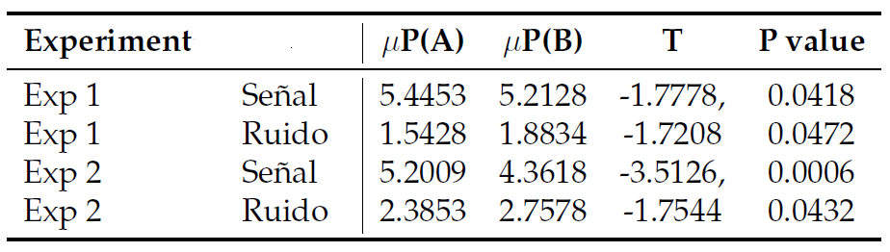
A) Replication of the analysis reported in the M.E. literature
1.- Make sure that d’(A) > d’(B)
2.- Comparing the Hit and F.A. rates to test the M.E. pattern of response
3.- Comparing the Mean confidence ratings assigned to each class of stimuli.

Slide 17
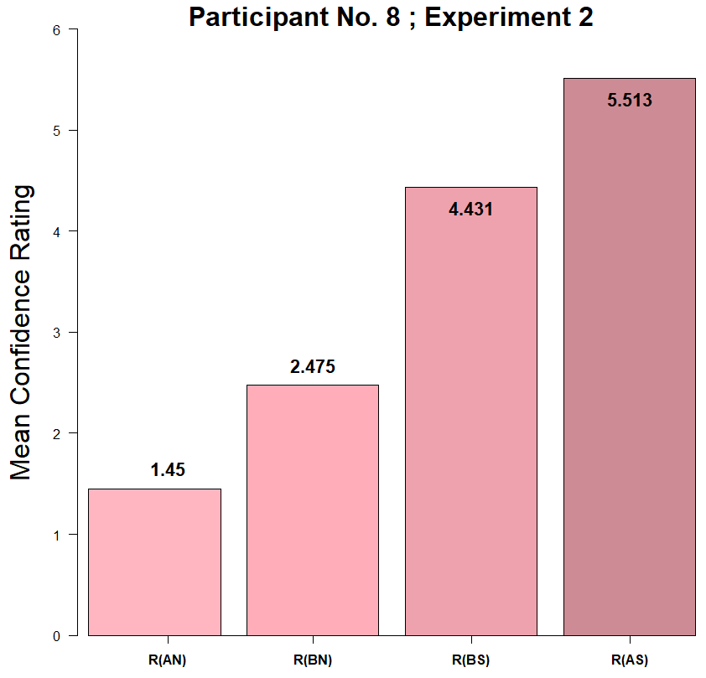
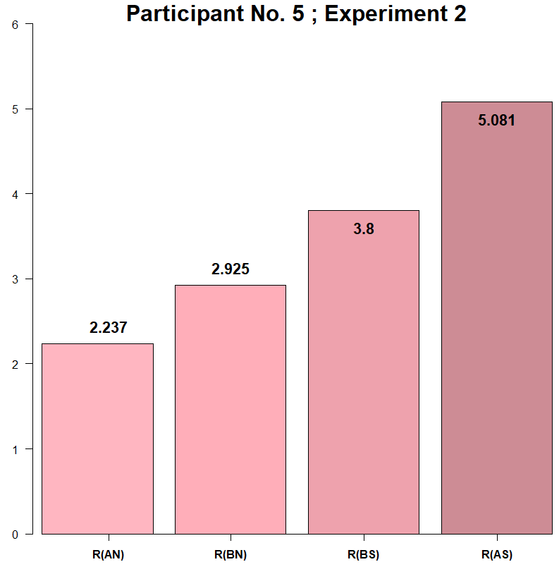
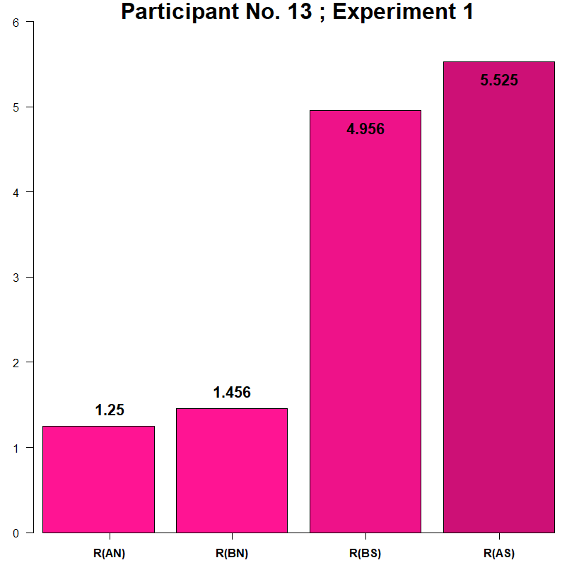
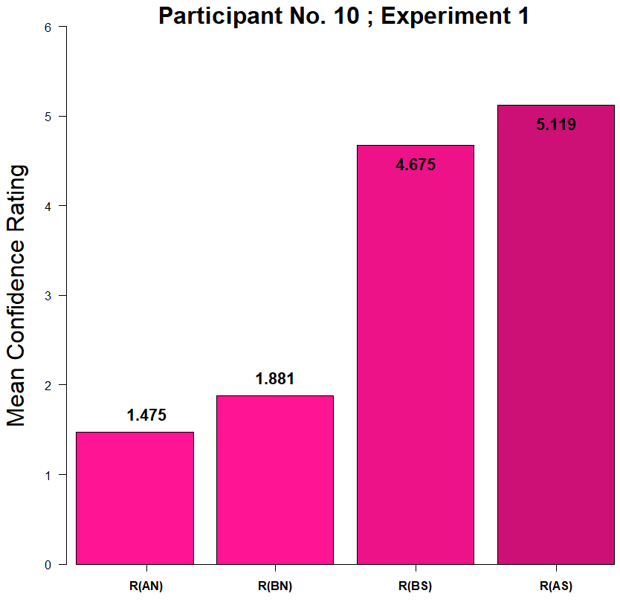
R(NoA) < R(NoB) < R(YesB) < R(YesA)

Slide 18
Results: Did we replicate the effect?

Slide 19
1. Making sure d’(A) > d’(B)
In order to make our results comparable to what has been reported on the literature of the Mirror Effect withing Recognition Memory, we have to be able to guarantee that our two clases of stimuli are indeed different in terms of how “difficult” they are.

Slide 20
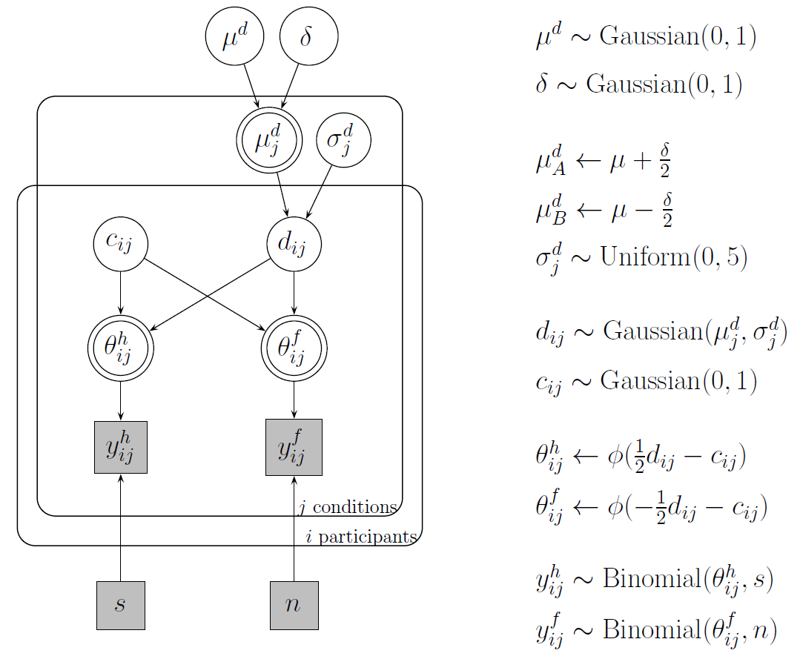

Slide 21
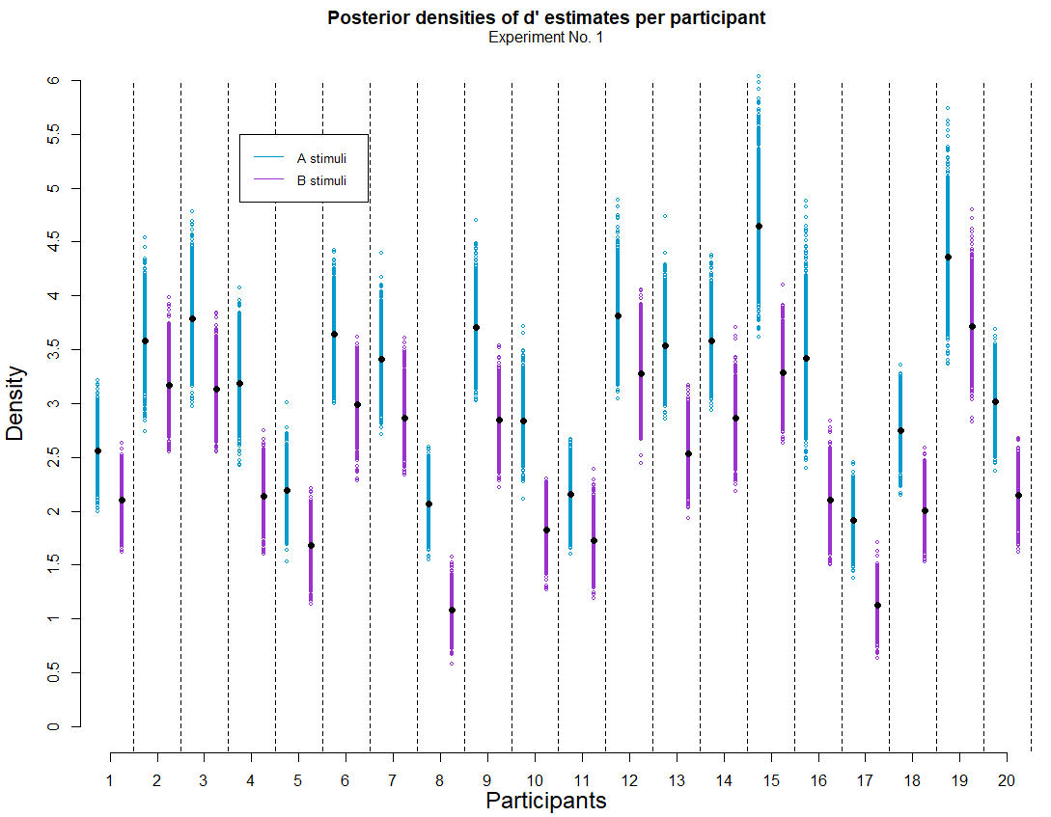
Plot 1
What’s important about this plot?
For all participants, d’ estimates are greater for A class stimuli than for B class.
Notes:
PS: Alex suggested me to use this kind of plot and I really liked it.

Slide 22
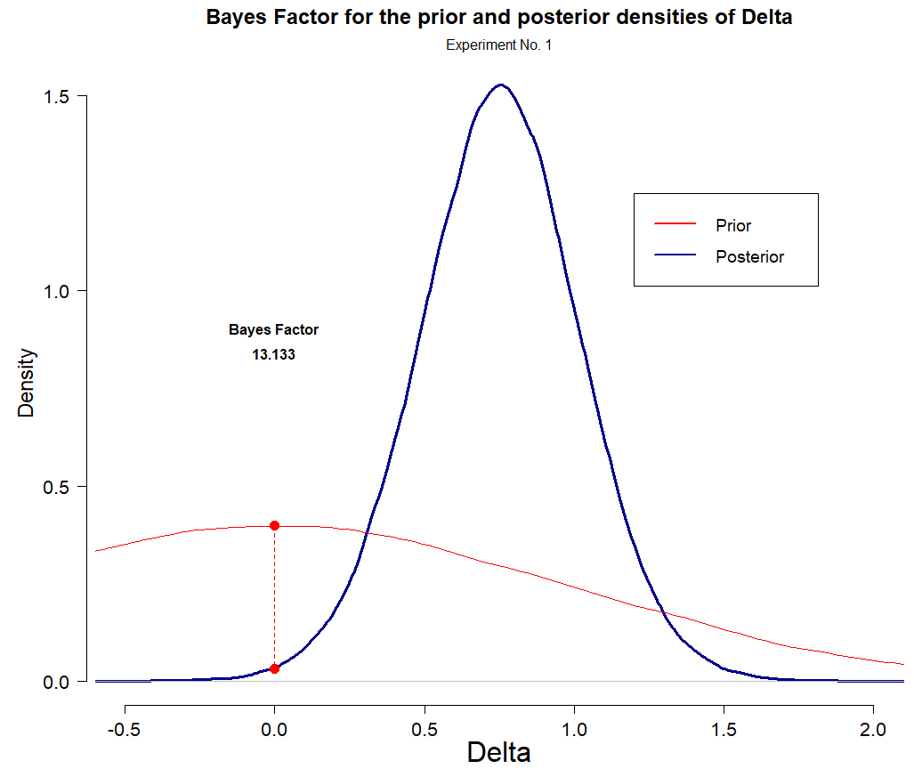
Plot 2
What’s important about this plot?
According to the Bayes Factor, the posterior estimates suggest that it’s 13 times lees likely that the difference between d’ across each class of stimuli is 0, than/from what had been stated on the prior.
Notes:
PS: Alex suggested me to use this kind of plot and I really liked it.

Slide 23
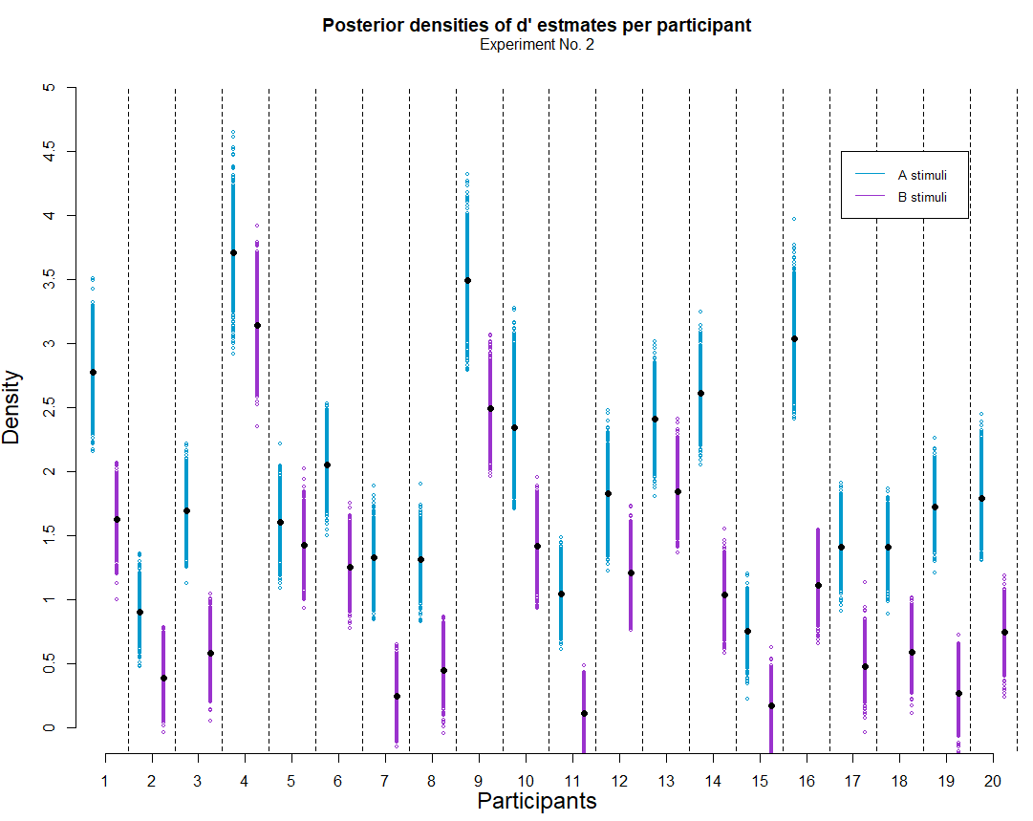
Plot 1
Same things happen in Experiment 2
For all participants, d’ estimates are greater for A class stimuli than for B class.
Notes:
PS: Alex suggested me to use this kind of plot and I really liked it.

Slide 24
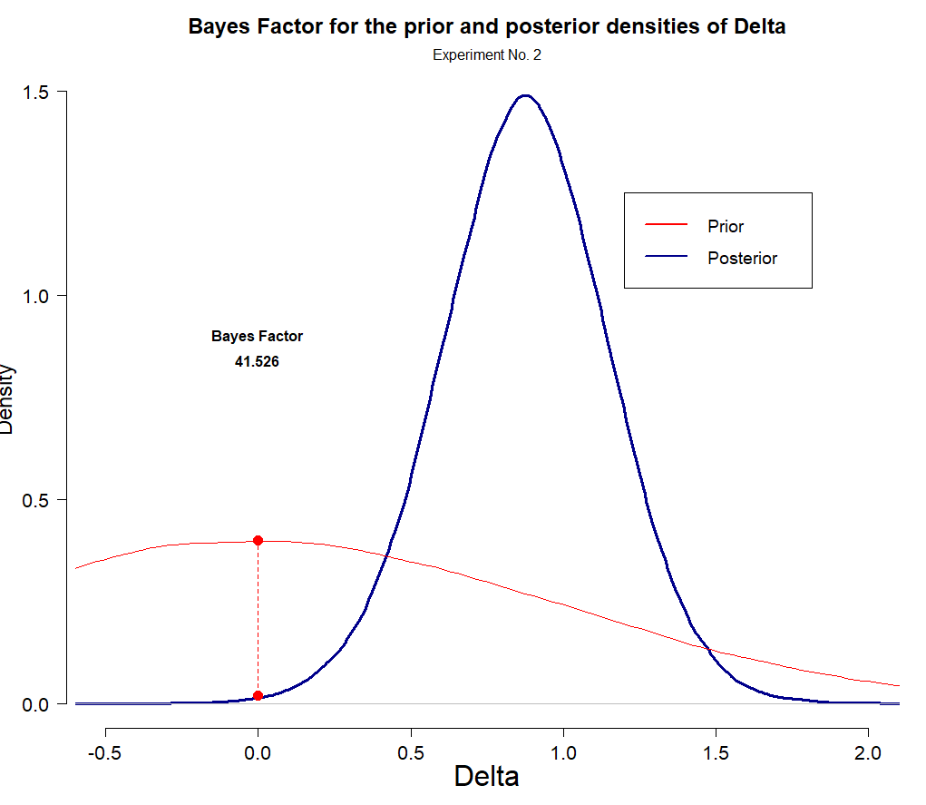
Plot 2
According to the Bayes Factor, the posterior estimates suggest that it’s 41.5 times lees likely that the difference between d’ across each class of stimuli is 0, than/from what had been stated on the prior.

Slide 25
2. Contaminant Bayesian modeling
In order to make our results comparable to what has been reported on the literatura of the Mirror Effect withing Recognition Memory, we have to be able to guarantee that our two clases of stimuli are indeed different in terms of how “difficult” they are.

Slide 26
2.1 A “simple” contaminant model
The experiment was programmed so that on each trial, participants could face a signal or noise trial from either class of stimuli completely at random.
Given the sturcture of the experiment, one would expect that “Yes” and “No” responses were registered with a fairly equal probability on each trial. We test this with a first mixture model for the plain “yes” “no” input registered by participants.

Slide 27
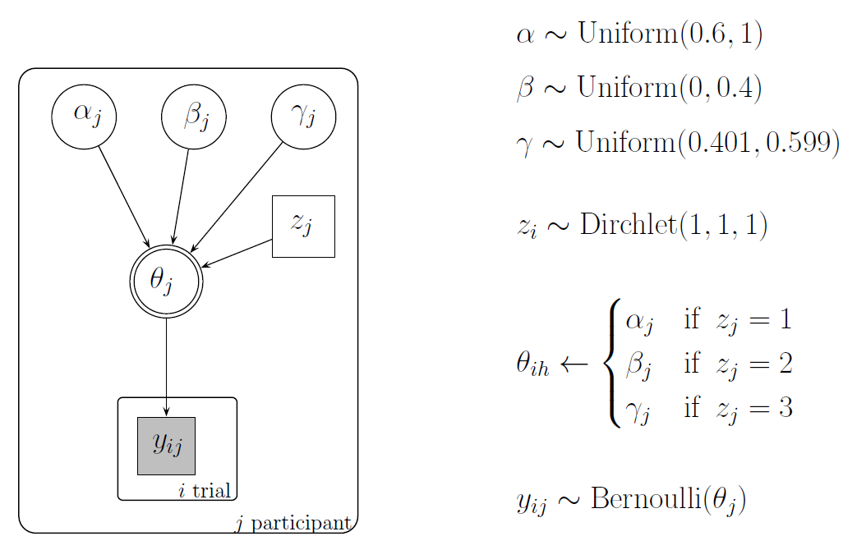

Slide 28
2.2 A “cognitive” contaminant model
A Mixture Model

Slide 29
3. Looking for the Mirror Effect
Comparing the Hit and F.A. rates across clases of stimuli to see if we can find the same pattern as the one reported in the literatura under the name of “the Mirror Effect”
FA(A) < FA(B) < H(B) < H(A)

Slide 30
3.1 Comparing binomial response rates

Slide 31
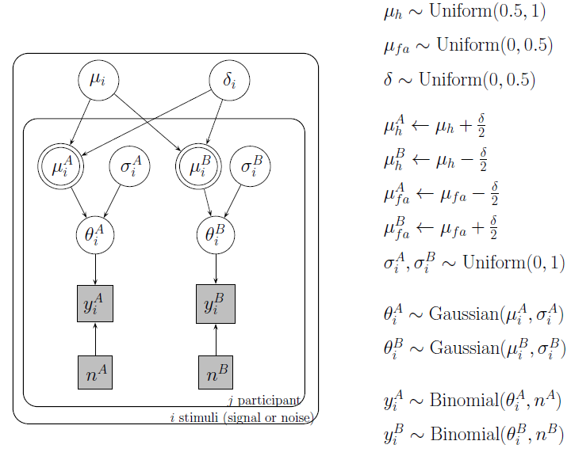

Slide 32
3.2 Comparing Hit rates and F.A. rates in the context of a Bayesian cognitive model
Using a Bayesian cognitive SDT model to look through the differences observed between the Hit and F.A. rates across clases of stimuli

Slide 33
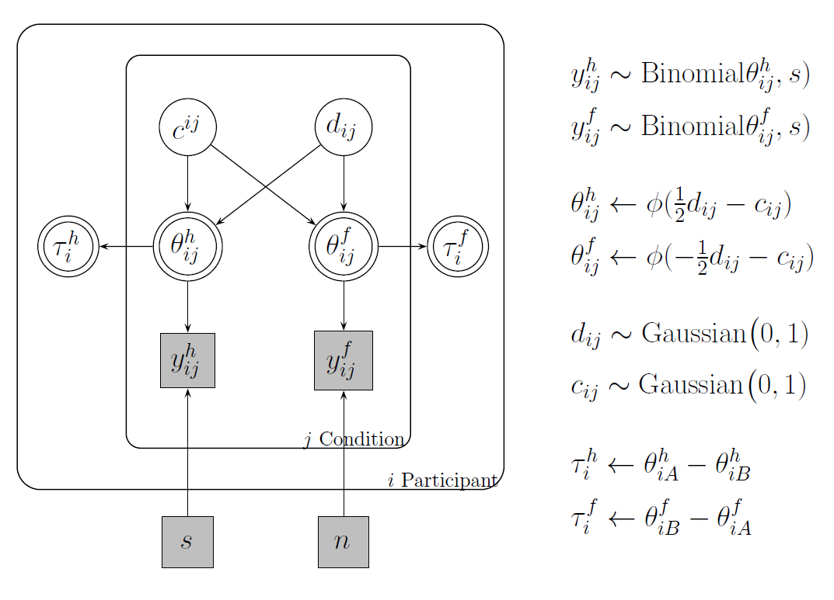

Slide 34
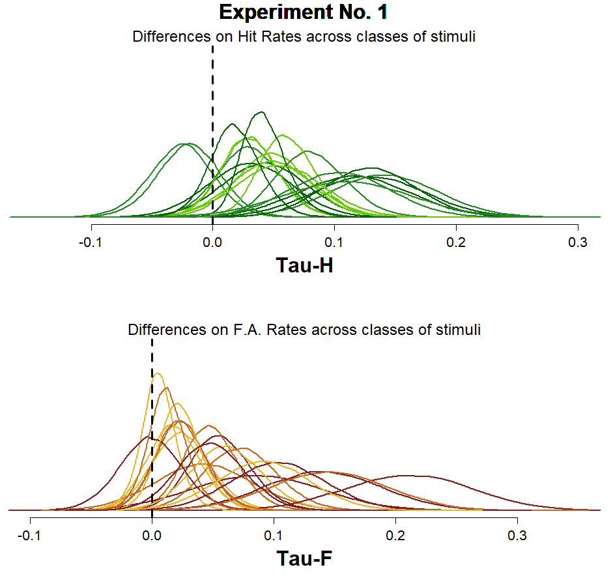
Plot 1
Based on the individual Tau-H and Tau-F posterior distributions being shown, it’s clear that there’s a lot of variability (even if “at first glance” one might be tempted to say that the majority of the posterior density lies to the right side of the “0 differences between classes” point).

Slide 35
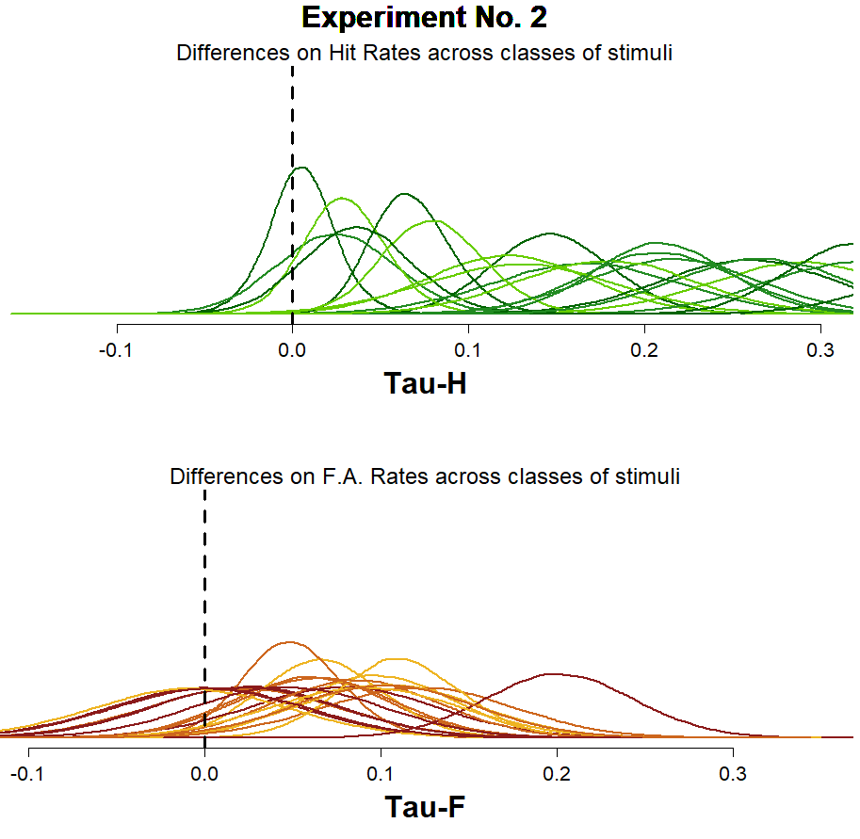
Plot 1
For Experiment 2, you can see that the estimates for the differences between the Hit Rates has clearly increased, at the same time that the estimates made for the differences between the FA rates seem to be a Little bit more clustered around 0.

Slide 36
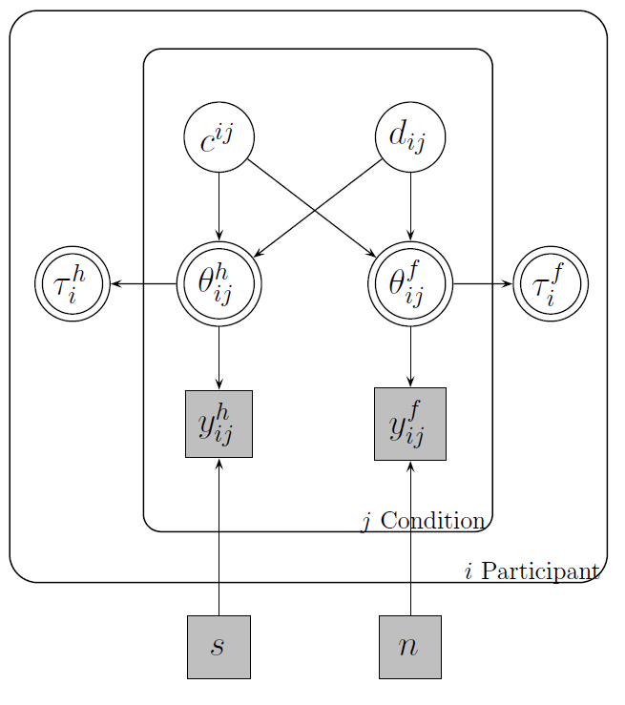

Given that this particular model was constructed so that both Taus are deterministically estimated, based on the indiviual estimations made for $θ_{ij}^{H}$ and $θ_{ij}^{F}$, conducting a Bayes Factor or any other density ratio measure might not seem like a straight-forward thing to do.

Slide 37
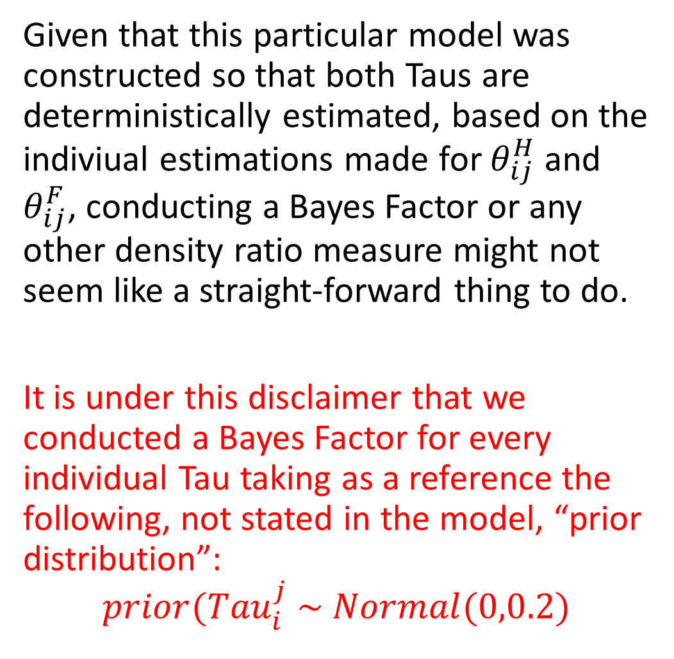
Given that this particular model was constructed so that both Taus are deterministically estimated, based on the indiviual estimations made for $θ_{ij}^{H}$ and $θ_{ij}^{F}$, conducting a Bayes Factor or any other density ratio measure might not seem like a straight-forward thing to do.
It is under this disclaimer that we conducted a Bayes Factor for every individual Tau taking as a reference the following, not stated in the model, “prior distribution”:
$$prior({Tau}_{i}^{j} \sim Normal(0,0.2)$$

Slide 38
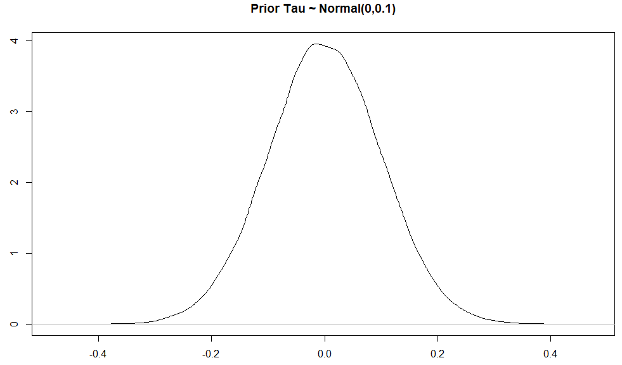
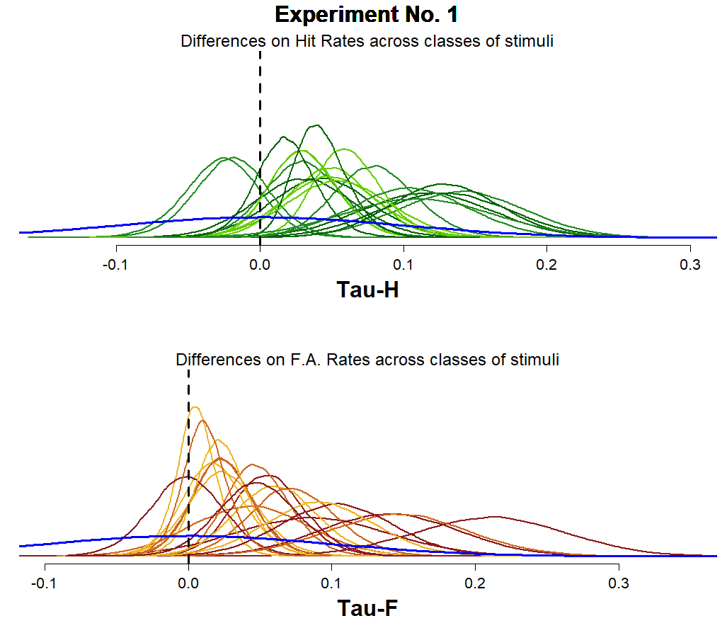

Given that this particular model was constructed so that both Taus are deterministically estimated, based on the indiviual estimations made for $θ_{ij}^{H}$ and $θ_{ij}^{F}$, conducting a Bayes Factor or any other density ratio measure might not seem like a straight-forward thing to do.
It is under this disclaimer that we conducted a Bayes Factor for every individual Tau taking as a reference the following, not stated in the model, “prior distribution”:
$$prior({Tau}_{i}^{j} \sim Normal(0,0.1)$$

Slide 39
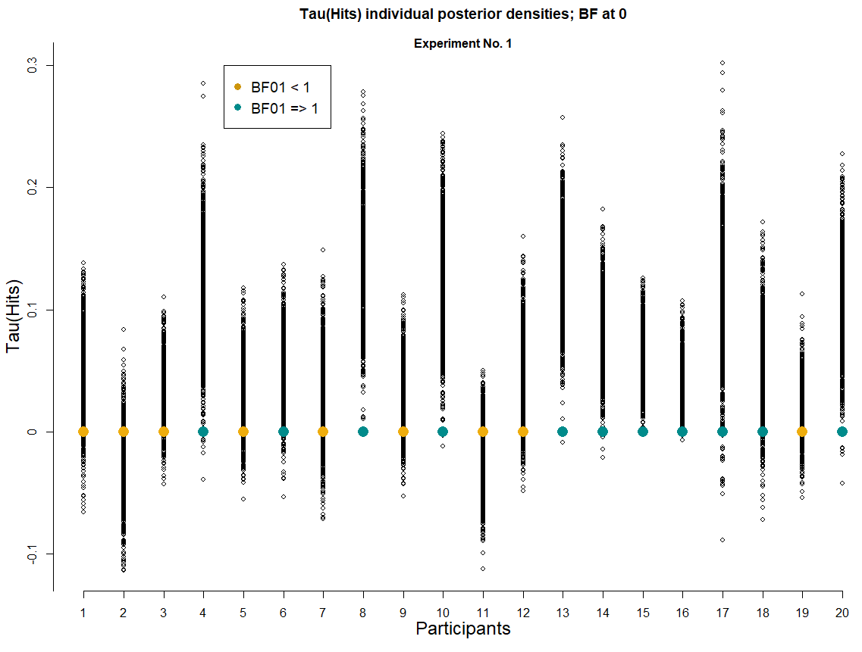
Plot 1
We can see that for Experiment No. 1, there are 9 participants (Golden color) who show a greater posterior desity at the 0 difference point between the Hit rates for each class of stimuli, compared to the artificial prior distribution proposed for reference.

Slide 40
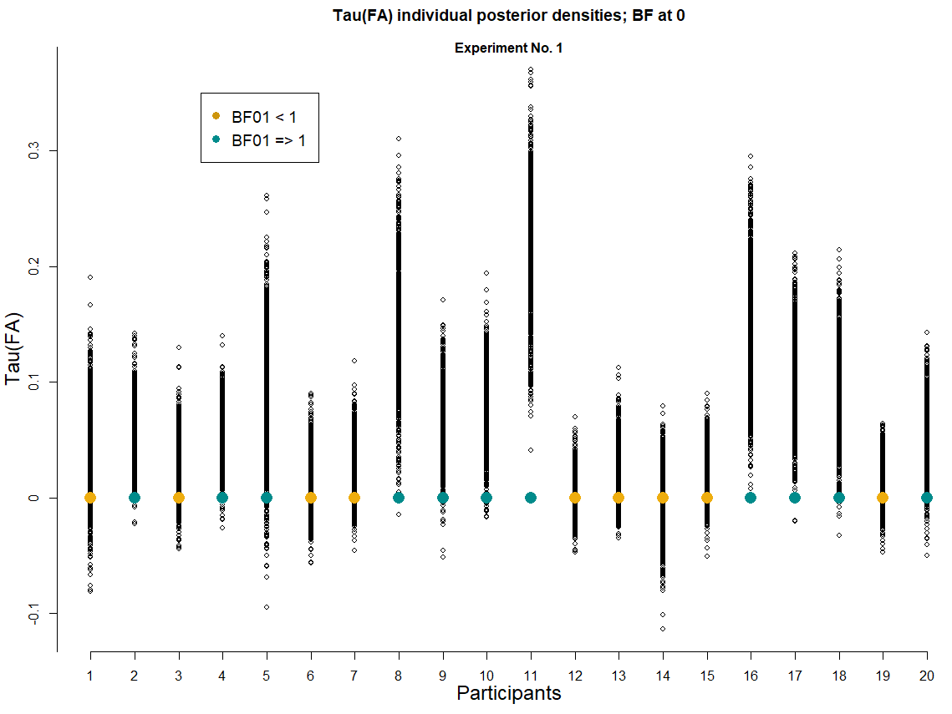
Plot 1
We can see that for Experiment No. 1, there are 9 participants (Golden color) who show a greater posterior desity at the 0 difference point between the False Alarms rates for each class of stimuli, compared to the artificial prior distribution proposed for reference.

Slide 41
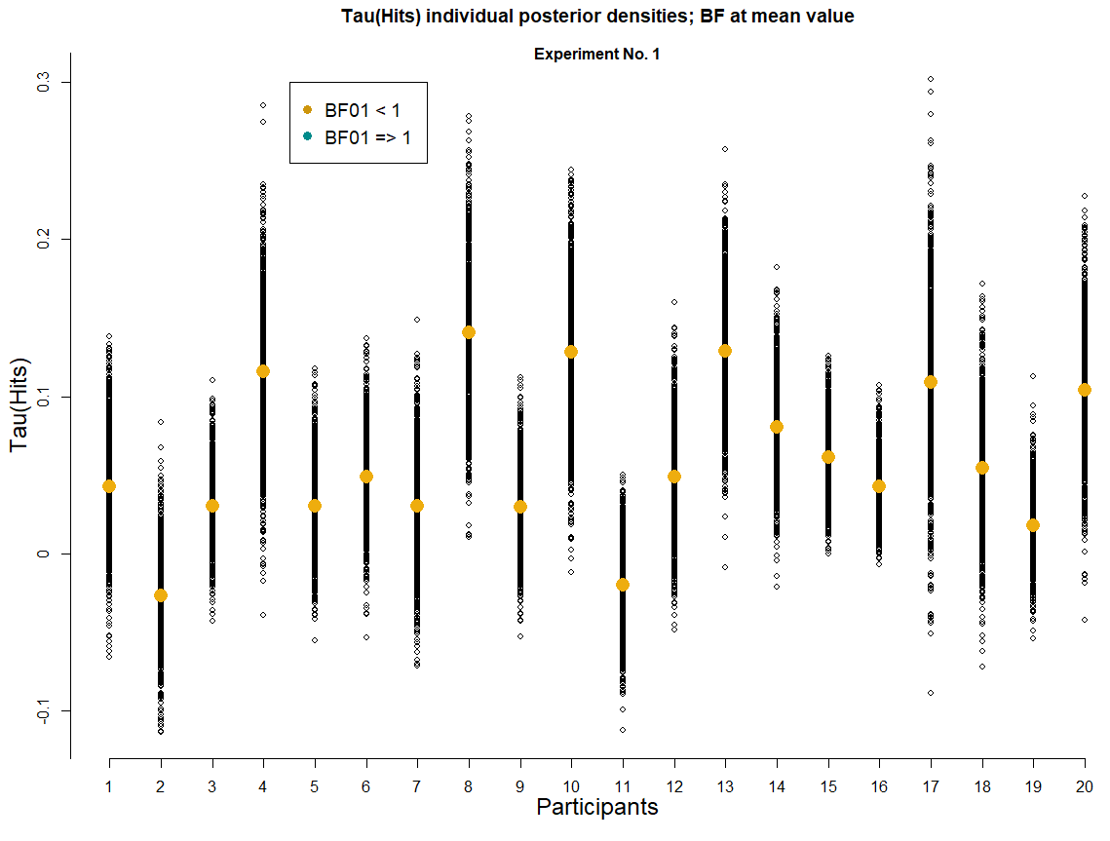
Plot 2
We can see that for Experiment No. 1, all participants had a greater posterior density at their mean value than the prior at this very same point.
I have doubts on whether or not this makes sense, please see the next slide for the details…

Slide 42
Plot 2
We can see that for Experiment No. 1, all participants had a greater posterior density at their mean value than the prior at this very same point.
Does this comparison even make sense? I mean, it’s pretty clear that no matter what the posterior distribution looks like… its mean is always going to have a greater density than the artificial prior

Slide 43
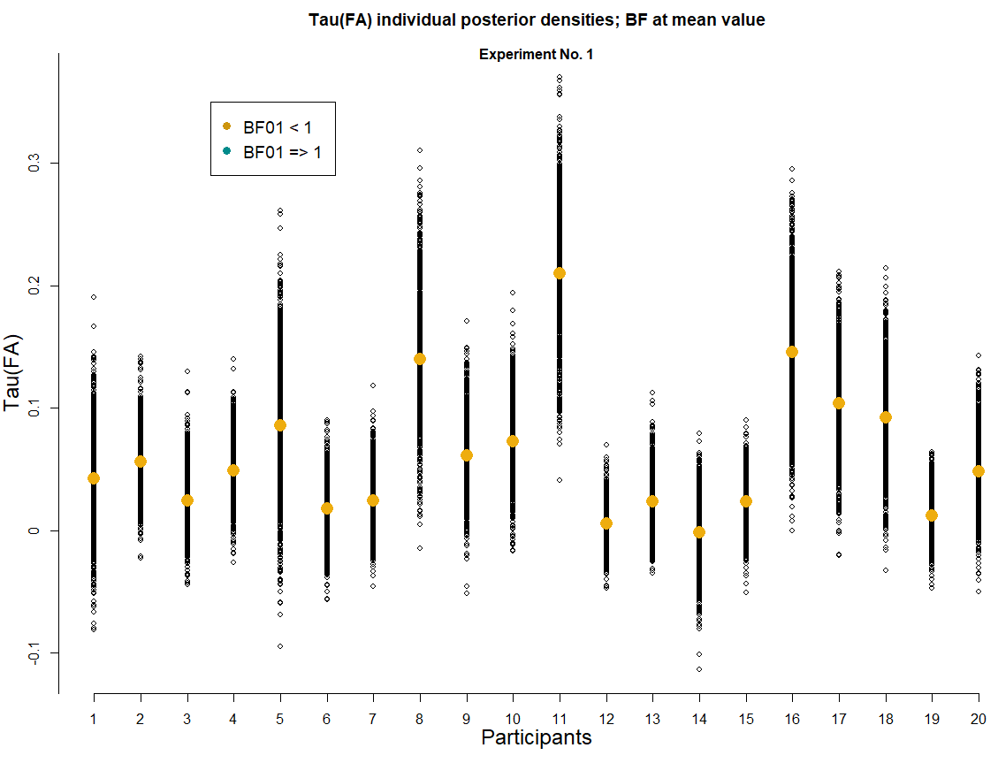
Plot 2
Same thing happens for the differences between the False Alarm rates from each class of stimuli and its Bayes Factor.
Same question as before, of course…

Slide 44
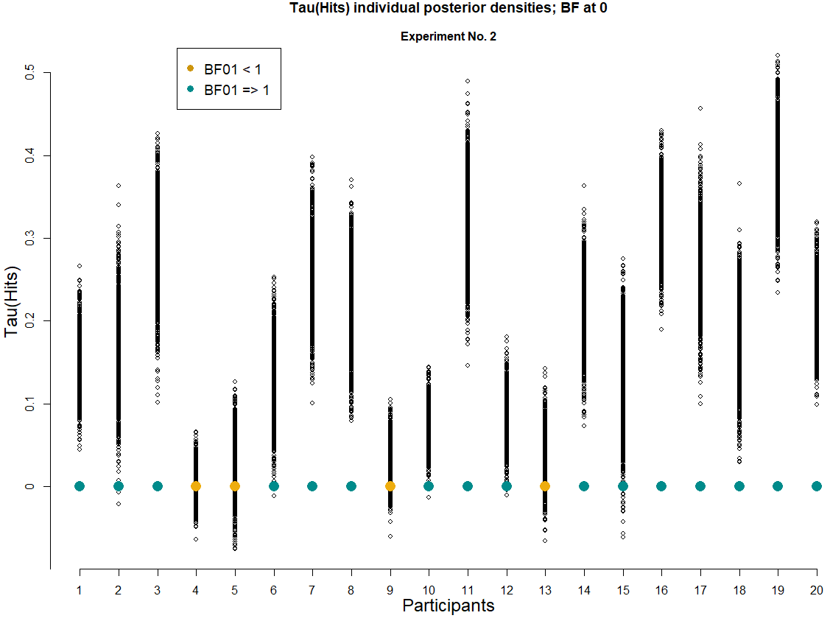
Plot 1
We can see that for Experiment No. 2, there are 4 participants who show a greater posterior density at the point of “0 differences” between the Hit rates of each class of stimuli, compared to the artificial prior.

Slide 45
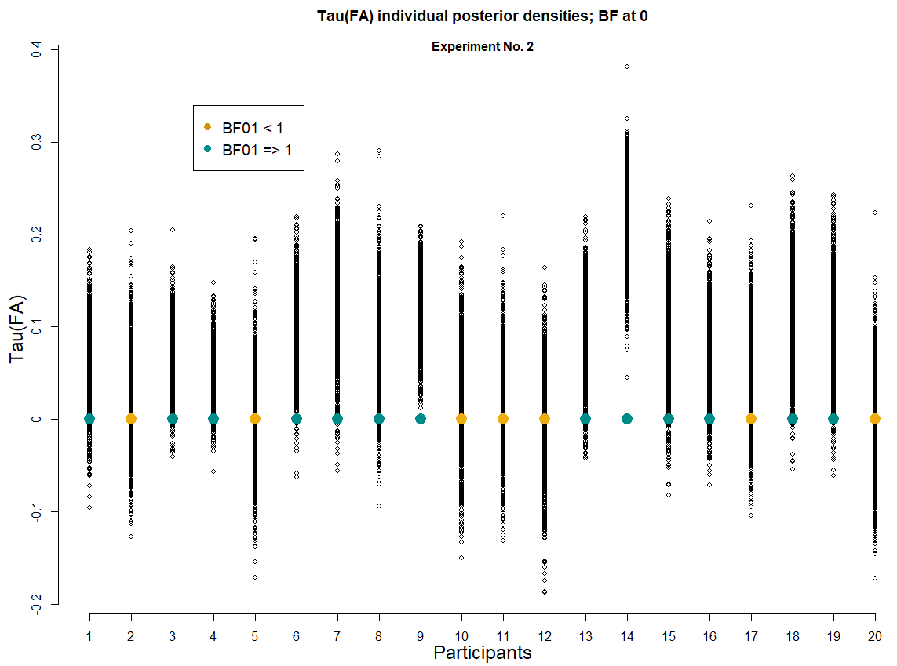
Plot 1
We can see that for Experiment No. 2, there are 7 participants who show a greater posterior density at the point of “0 differences” between the False Alarms rates of each class of stimuli, compared to the artificial prior.

Slide 46
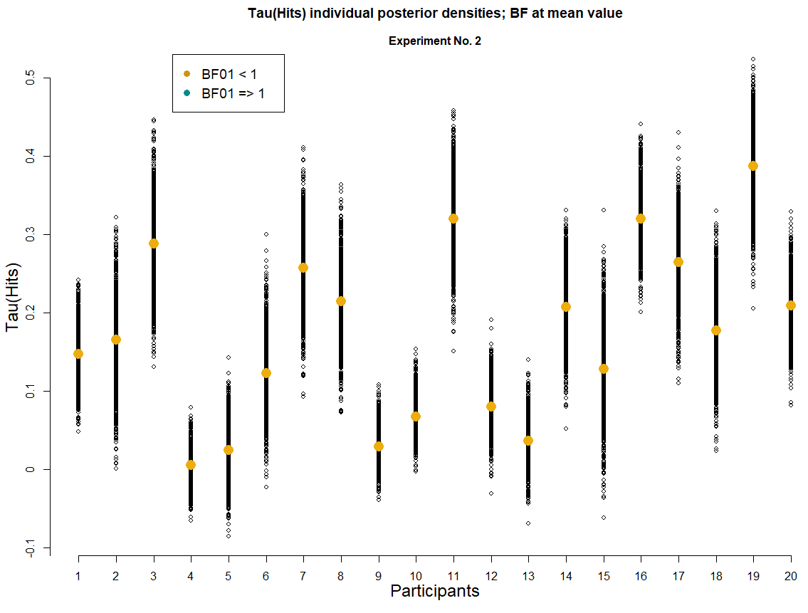
Plot 2
Once again, for the differences between the Hit rates at Experiment No. 2 when we measure the Bayes Factor between the artificial prior and the posterior distributions at the mean value of the posterior, all participants show a greater posterior density tan the prior.
Same question as before, of course…

Slide 47
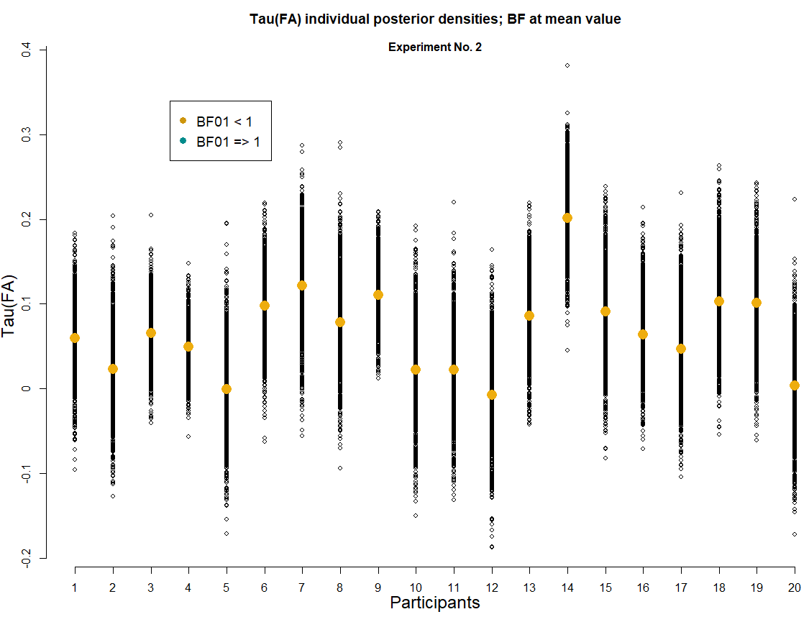
Plot 2
Once again, for the differences between the False Alarms rates at Experiment No. 2 when we measure the Bayes Factor between the artificial prior and the posterior distributions at the mean value of the posterior, all participants show a greater posterior density tan the prior.
Same question as before, of course…

Slide 48
Some sort of conclusion from the past section
Many of the main findings/empirical phenomena reported within Psychology tend to do it in terms of the “mean performance” of all participants.
It is interesting to note that when we conducted a step-by-step replication of the statistical tests that had been reported within the Recognition Memory literature focused on studying the Mirror Effect (t-test with an arcsine comparison of the response rates), we also find “evidence for the Mirror Effect” in our merely perceptual task, (which was itself a very interesting finding in terms of what it suggest about the validity of the models and theories developed to account for the Mirror Effect as a Recognition Memory phenomenom).
However, the presented variation of a Bayesian SDT cognitive model seems to be suggesting that the Mirror Effect could be a phenomena that holds for the “whole group” analysis, but not the individual level.

Slide 49
The present study could serve as a clear reference of the advantages that Bayesian Cognitive modeling has in terms of the general conclusions that can arise from its application, given the great power it has shown to deal with the individual data.
(I’m trying to stay conservative and not take it too far… but this is the general direction that the conclusions arised from this first part would have)

Slide 50
3. Bayesian hierarchical cognitive modeling of our data
Ok, we already know what’s happening in terms of our d’, but, is there any good reason not to look into c estimates as well?

Slide 51
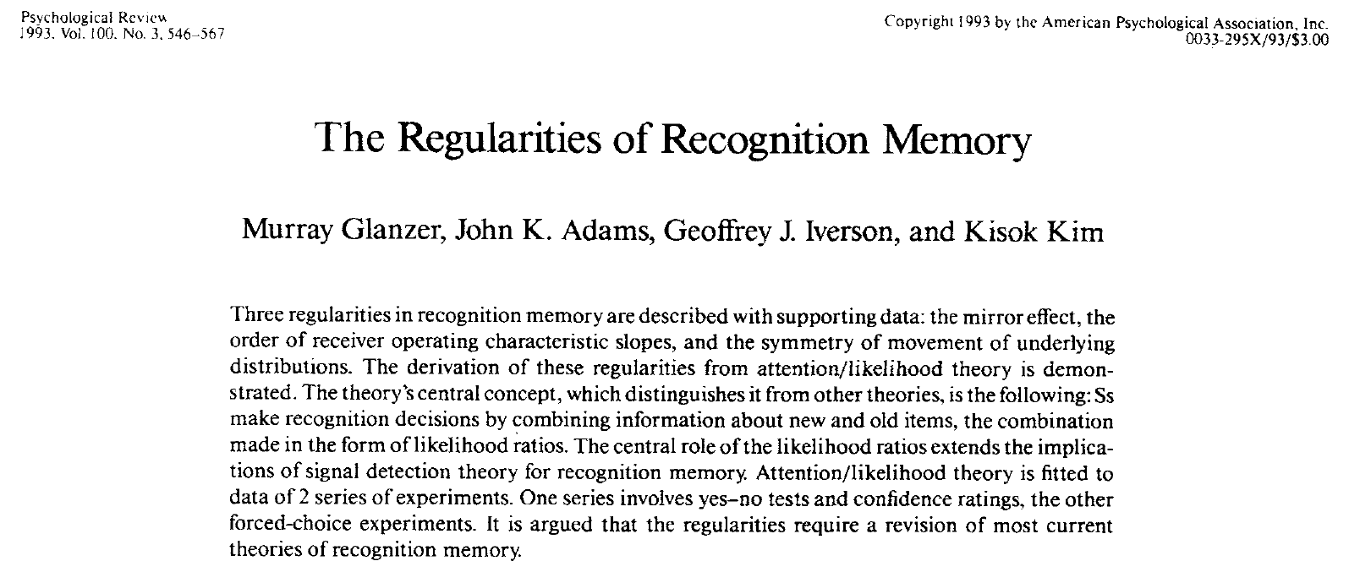
According to this article:

Slide 52
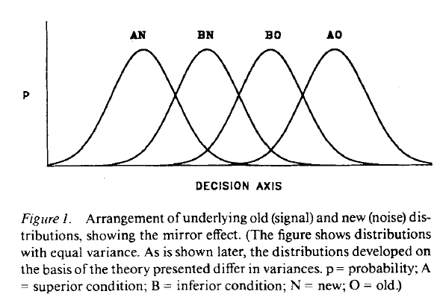
1) There’s a single criterion

Slide 53
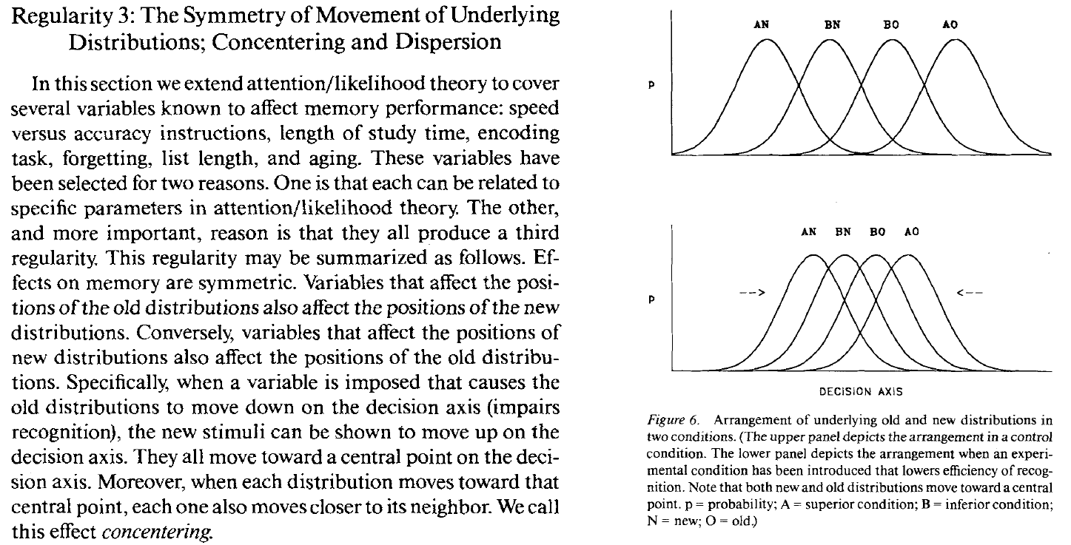
2)

Slide 54
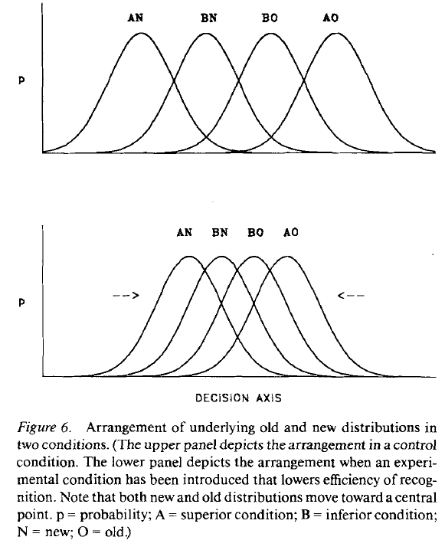
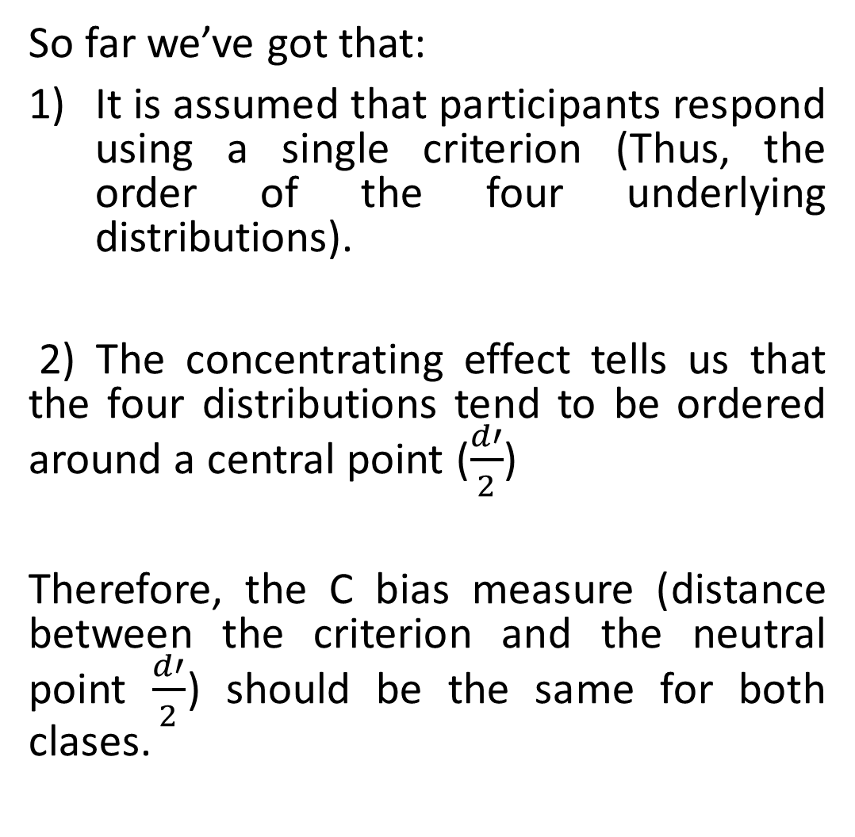
So far we’ve got that:
It is assumed that participants respond using a single criterion (Thus, the order of the four underlying distributions).
2) The concentrating effect tells us that the four distributions tend to be ordered around a central point ($\frac{d′}{2}$)
Therefore, the C bias measure (distance between the criterion and the neutral point $\frac{d′}{2}$) should be the same for both clases.

Slide 55
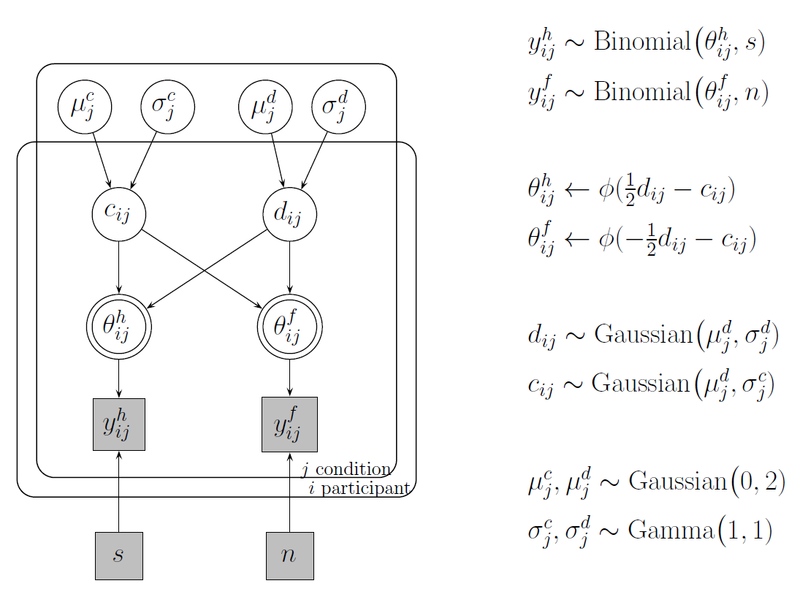
We apply a Hierarchical Bayesian SDT model

Slide 56
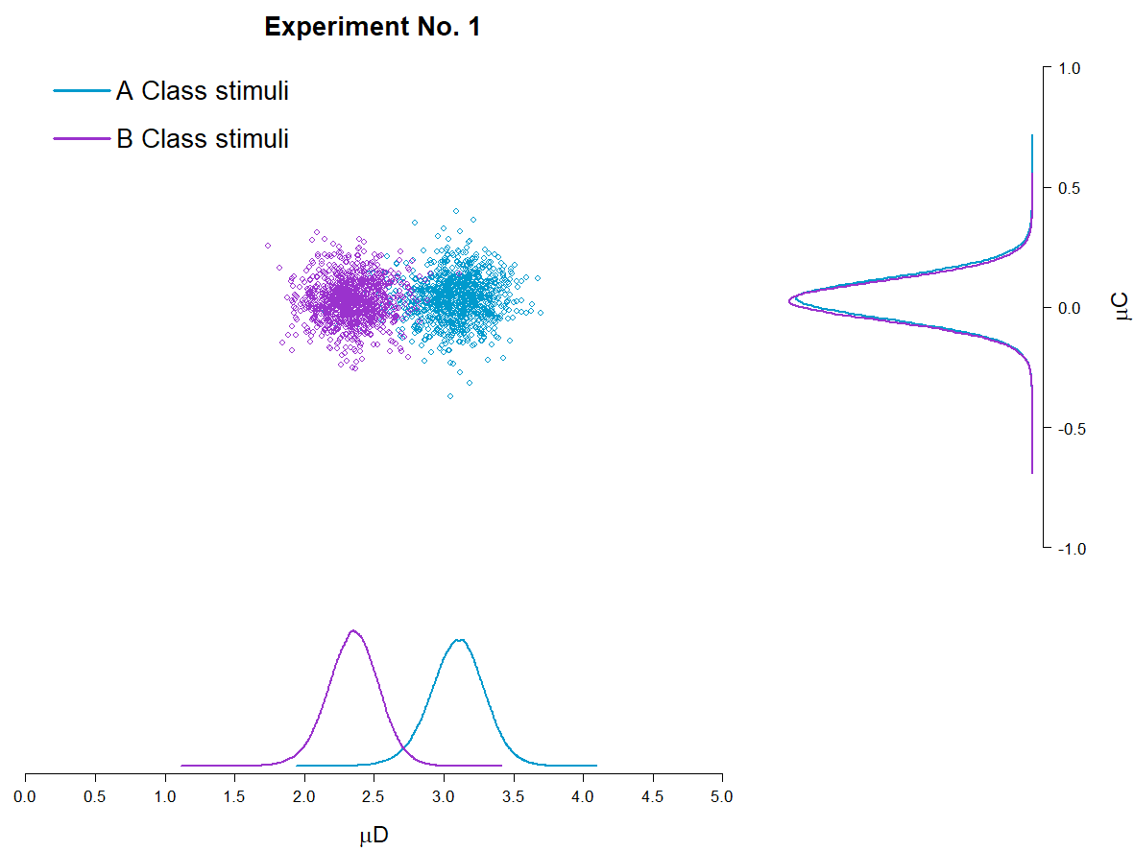
Plot 1
It is interesting to note that for Experiment No. 1, yes, some differences are found in terms of the mean d’ estimations for each class of stimuli, but this doesn’t happen for C, which according to the proposed hierarchical model could be described by the same mean value for both classes of stimuli.

Slide 57
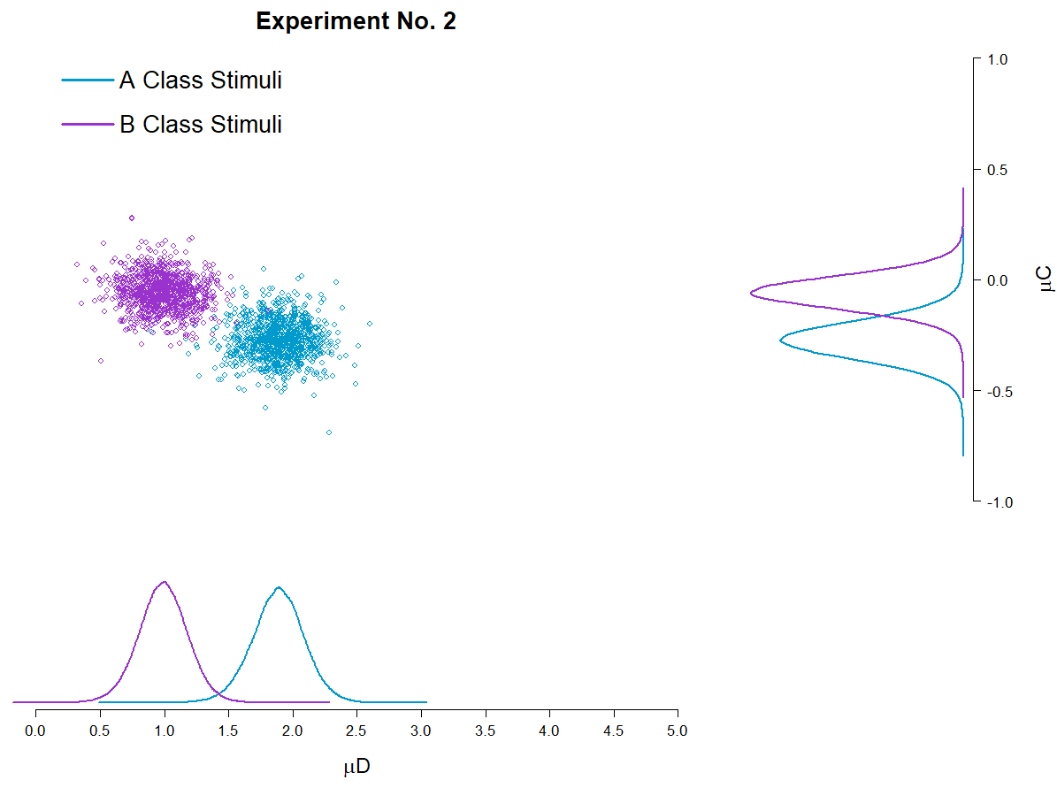
Plot 1
Even more interesting should be the fact that this doesn’t hold up for Experiment No. 2, where differences between classes of stimuli are observed both for d’ and C.

Slide 58
4. Step change point modeling
PENDING
Do participants face changes in D’ or C across trials?

Slide 59
5. Testing an Unequal Variance Model
PENDING
What can be inferred from the Confidence rating data?

Slide 60
5.1 Are participants using all of the Confidence Ratings ?
PENDING

